Slide 1
Design Laboratory EE-305
Simple PI-PD tuning rules based on the centroid of the stability region for controlling unstable and integrating processes
Supervisor:– Prof. Ahmad Ali
Presenter – Priya Raj(2001EE46)

Slide 2
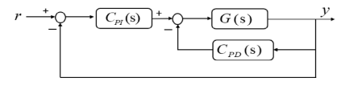
WHY ANALYSIS OF PI-PD CONTROLLERS?
Tuning PI-PD controllers has been the subject of concentrated research in recent years because of the fact of PID controllers not being suitable for controlling unstable and integrating process with time delay.
The integral part of PID controller disadvantages its performance by overestimating the overshoots. To overcome this disadvantage and improve the closed-loop performance we suggest PI-PD.
Block diagram of PI-PD control structure-

Slide 3


We have studied 2 class of Integrating process-
UFOPTD Process – Unstable plus First Order Plus Time Delay
IFOPTD Process – Integrating plus First Order Plus Time Delay

Slide 4
What problem has been solved in the paper?
The approach for designing the parameters of PI-PD controller by using the CCSR (centroid of the convex stability boundary locus approach) is time consuming as it requires deriving equations for constructing the stability of PI-PD controller and its accuracy of computations is also questionable.
To overcome this challenge simple tuning rules for computing gains of PI-PD controller is being suggested as it removes the disadvantage of CCSR having complex calculations. We replaced the centroid of convex stability boundary locus approach by centroid of stability region.
The application of CCSR is extended from using it for unstable processes only to controlling integrating processes.

Slide 5
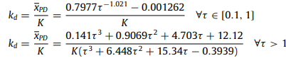
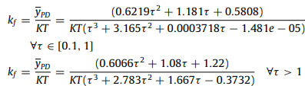
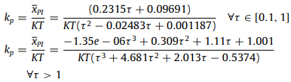


Proposed tuning rules in the case of IFOPDT processes
Derived parameters:-
.

Slide 6
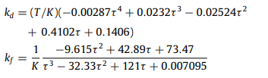

Proposed tuning rules in the case of UFOPDT processes
Derived parameters:-

Slide 7
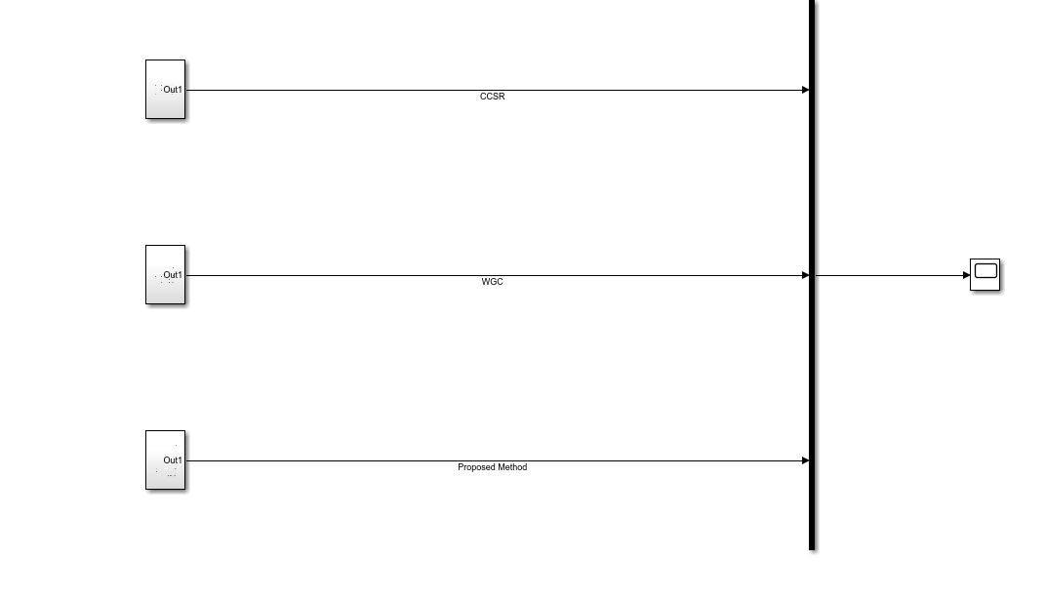
Simulation with UFOPTD process model –
G(s) = 3.433e^(−20s) /(103.1s − 1)

Slide 8
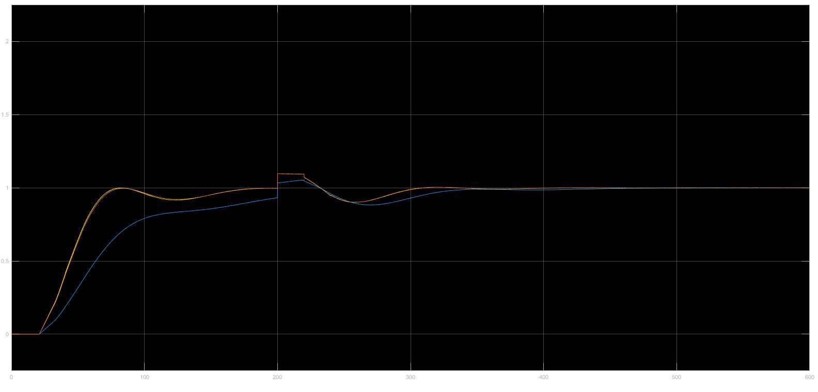
Simulation result with UFOPTD process model with transfer function –
G(s) = 3.433e^(−20s) /(103.1s - 1) ccsr, wgc, proposed

Slide 9

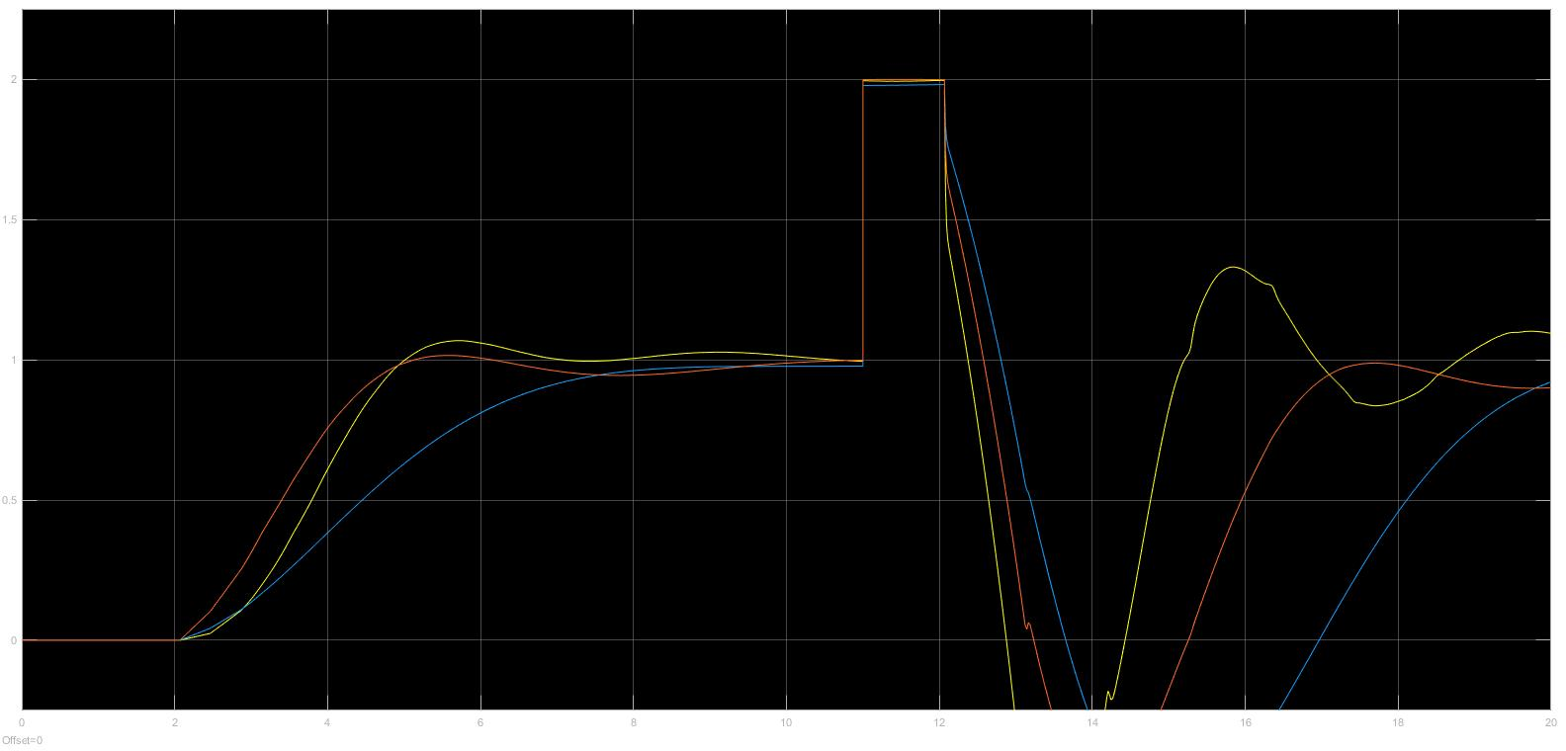
Simulation result with UFOPTD process model with transfer function–
G(s) = e^(−1.067s) /(2.347s − 1)

Slide 10
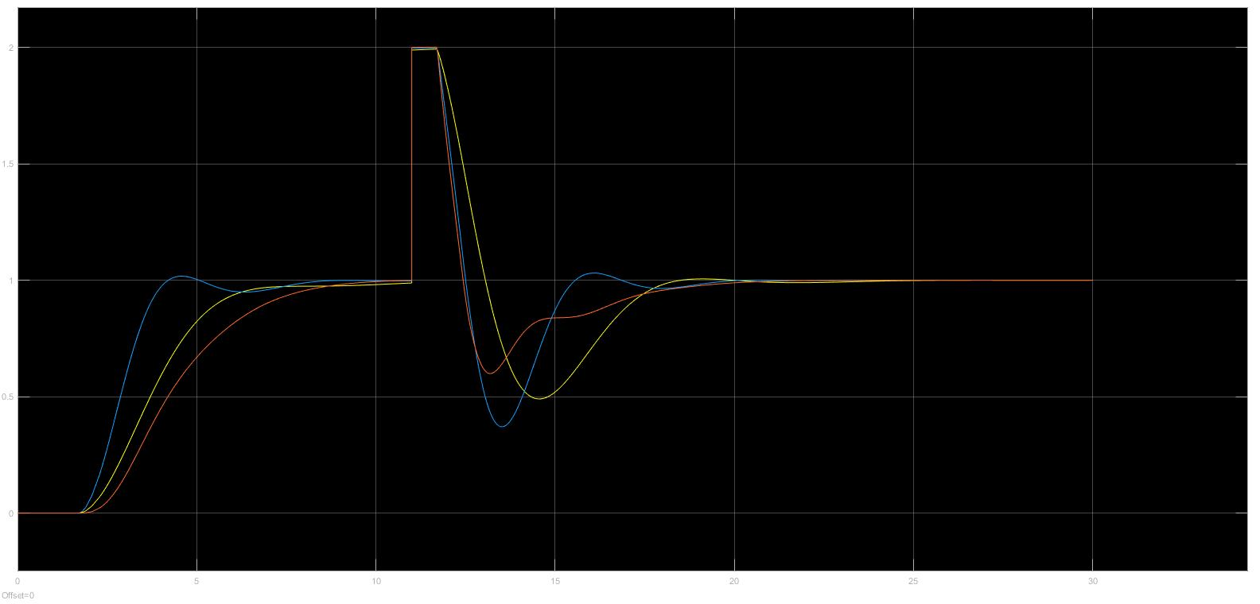
Simulation result with IFOPTD process model with transfer function–
G(s) = e −0.7s /s(0.3s+1)

Slide 11
Simulation result with IFOPTD process model with transfer function–
G(s) ≈ e −6.667s /s(10.141s+1)

Slide 12
Simulation analysis:-
Proposed method and the CCSR method have very identical responses. Proposed method performs better than WGC method in terms of having a smaller settling time. The suggested approach does not produce sluggish responses, especially for disturbance rejection, as WGC does.
CCSR has a quicker response than the suggested tuning rules. The suggested method might have the strongest performance against the measurement noise compared to all the reported methods.
Proposed method gives a quick response with a small tracking error and a better disturbance rejection compared to WGC. Suggested method introduces a very small overshoot.
The proposed method and WGC behave similarly under the measurement noise. WGC provides more robust performance in the case of positive parameter variations than the proposed approach. The proposed approach supplies the smallest set-point tracking error compared to all the reported methods.

Slide 13
Conclusion
The proposed tuning rules remove the disadvantages of CCSR of having complex calculations and using visual observations for obtaining the centroid of the stability region. To derive these tuning rules, a new analytical version of CCSR based on curve fitting is proposed.
A robustness analysis is provided to predict the closed-loop performance of the suggested tuning rules.
Simulation and experimental results showed that the proposed method has provided a very satisfactory performance compared to the methods reported in the literature for unstable and integrating processes.

Slide 14
References
Ozyetkin MM, Onat C, Tan N. PI-PD controller design for time delay systems via the weighted geometrical center method. Asian J Control 2019;1–16. http://dx.doi.org/10.1002/asjc.2088.Ali, A., & Majhi, S. (2010). PID controller tuning for integrating processes. ISA Transactions, 49, 70–78.
Onat C. A new design method for PI–PD control of unstable processes with dead time. ISA Trans 2019;84:69–81. http://dx.doi.org/10.1016/j. isatra.2018.08.029

Slide 15


